Slide 1
“ DIJKSTRA ALGORITHM”
A presentation on
Prepared by:
Asst. Prof. Umesh M. Kulkarni,
Asst. Prof., Dept. of CSE,
KLSGIT, Belagavi.

Slide 2
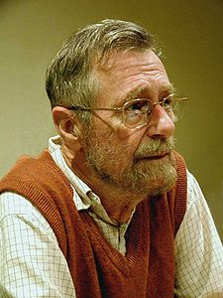
The author: Edsger Wybe Dijkstra
May 11, 1930 – August 6, 2002
Received the 1972 A. M. Turing Award, widely considered the most prestigious award in computer science.
The Schlumberger Centennial Chair of Computer Sciences at The University
of Texas at Austin from 1984 until 2000
Made a strong case against use of the GOTO statement in programming languages and helped lead to its deprecation.
Known for his many essays on programming.

Slide 3
Dijkstra's algorithm
Problem Definition: From a given vertex in a weighted connected graph, find shortest paths to other vertices using Dijkstra's algorithm.
CSE@GIT

Slide 4
Objectives of the Experiment:
To apply the Greedy Technique.
Present the working of Dijkstra Algorithm.
Learn to write Algorithm in standard form.
Find out shortest path from single source to other nodes in the graph

Slide 5
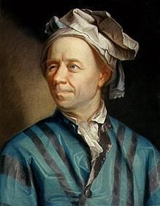
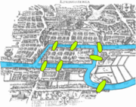
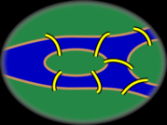
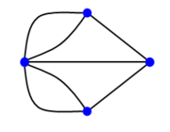
Graph Theory - History
Leonhard Euler's paper on “Seven Bridges of Königsberg” ,
published in 1736.

Slide 6
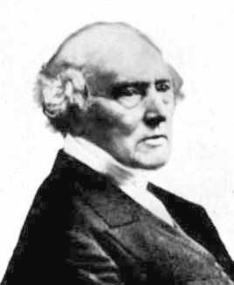
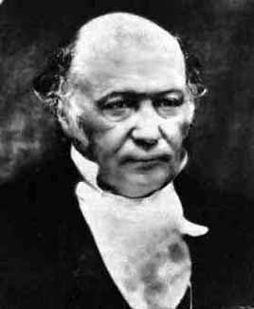
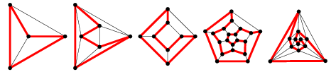
Graph Theory - History
Cycles in Polyhedra
Thomas P. Kirkman William R. Hamilton
Hamiltonian cycles in Platonic graphs

Slide 7
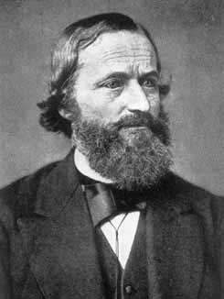
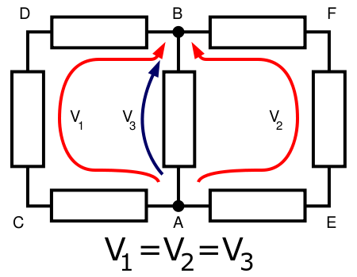
Graph Theory - History
Trees in Electric Circuits
Gustav Kirchhoff

Slide 8
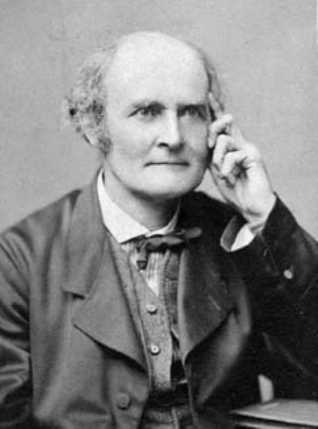
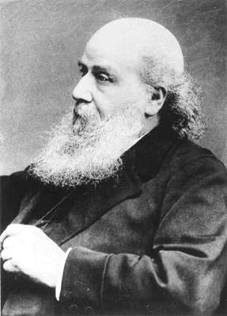
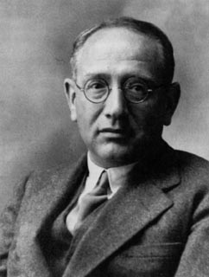
Graph Theory - History
Enumeration of Chemical Isomers
Arthur Cayley James J. Sylvester George Polya

Slide 9
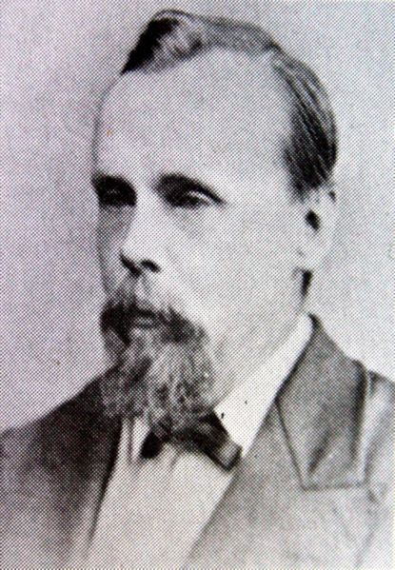
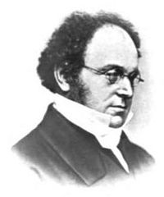
Graph Theory - History
Four Colors of Maps
Francis Guthrie Auguste DeMorgan

Slide 10
Definition: Graph
G is an ordered triple G:=(V, E, f)
V is a set of nodes, points, or vertices.
E is a set, whose elements are known as edges or lines.
f is a function
maps each element of E
to an unordered pair of vertices in V.

Slide 11
Definitions
Vertex
Basic Element
Drawn as a node or a dot.
Vertex set of G is usually denoted by V(G), or V
Edge
A set of two elements
Drawn as a line connecting two vertices, called end vertices, or endpoints.
The edge set of G is usually denoted by E(G), or E.

Slide 12
Example
V:={1,2,3,4,5,6}
E:={{1,2},{1,5},{2,3},{2,5},{3,4},{4,5},{4,6}}

Slide 13
Simple Graphs
Simple graphs are graphs without multiple edges or self-loops.

Slide 14
Directed Graph (digraph)
Edges have directions
An edge is an ordered pair of nodes
loop
multiple arc
arc
node

Slide 15
Weighted graphs
1.2
2
1
2
3
1
2
3
.2
.5
1.5
5
3
.3
1
4
5
6
4
5
6
.5
is a graph for which each edge has an associated weight, usually given by a weight function w: E → R.

Slide 16
Greedy Technique
Constructs a solution to an optimization problem piece by
piece through a sequence of choices that are:
feasible, i.e. satisfying the constraints
locally optimal (with respect to some neighborhood definition)
greedy (in terms of some measure), and irrevocable
For some problems, it yields a globally optimal solution for every instance. For most, does not but can be useful for fast approximations. We are mostly interested in the former case in this class.
Defined by an objective function and a set of constraints

Slide 17
Applications of the Greedy Strategy
Optimal solutions:
change making for “normal” coin denominations
minimum spanning tree (MST)
single-source shortest paths
simple scheduling problems
Huffman codes
Approximations/heuristics:
traveling salesman problem (TSP)
knapsack problem
other combinatorial optimization problems

Slide 18
Animations of Dijkstra’s algorithm
Animation -1
Animation -2
Animation -3

Slide 19
Shortest paths – Dijkstra’s algorithm
Single Source Shortest Paths Problem: Given a weighted
connected (directed) graph G, find shortest paths from source vertex s
to each of the other vertices
Dijkstra’s algorithm: Similar to Prim’s MST algorithm, with
a different way of computing numerical labels: Among vertices
not already in the tree, it finds vertex u with the smallest sum
d_{v} + w(v,u)
where
v is a vertex for which shortest path has been already found on preceding iterations (such vertices form a tree rooted at s)
d_{v} is the length of the shortest path from source s to v w(v,u) is the length (weight) of edge from v to u

Slide 20
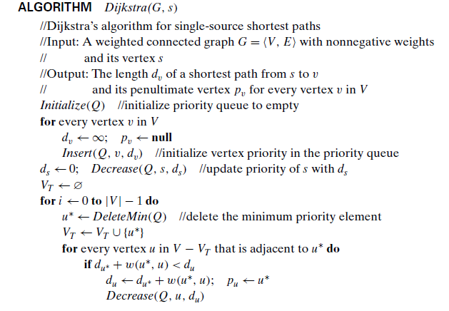
Dijkstra’s Algorithm
Intitial call is dijkstra(G[][], V)

Slide 21

Example -1
Tree vertices Remaining vertices
a(-,0) b(a,3) c(-,∞) d(a,7) e(-,∞)
4
b
c
3
2
6
5
a
7
d
4
e
b(a,3) c(b,3+4) d(b,3+2) e(-,∞)
b
4
c
3
6
2
5
a
7
d
4
e
d(b,5) c(b,7) e(d,5+4)
b
4
c
3
6
2
5
a
7
d
4
e
c(b,7) e(d,9)
4
b
c
3
6
2
5
a
7
d
4
e
e(d,9)

Slide 22
Example -1
from a to b : a − b of length 3
from a to d : a − b − d of length 5
from a to c : a − b − c of length 7
from a to e : a − b − d − e of length 9

Slide 23
Example -1 execution
Enter the number of vertices
5
Enter the Weighted Matrix for the graph
0 3 0 7 0
3 0 4 2 0
0 4 0 5 6
7 2 5 0 4
0 0 6 4 0
Enter the source
1
The Shorted Path to all nodes are
1 to 1 is 0
1 to 2 is 3
1 to 3 is 7
1 to 4 is 5
1 to 5 is 9
BUILD SUCCESSFUL (total time: 51 seconds)

Slide 24
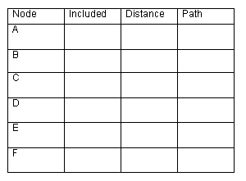
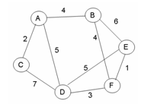
Example -2
-
-
t
f
t
4
A
f
t
2
A
f
t
5
A
∞
-
B
F
f
t
10
9
f
t
∞
8
-
B
Give the shortest path tree for node A for this graph using Dijkstra’s shortest path algorithm. Show your work with the 3 arrays given and draw the resultant shortest path tree with edge weights included.

Slide 25
Efficiency of Dijkstra’s algorithm
Correctness can be proven by induction on the number of vertices.
Doesn’t work for graphs with negative weights (whereas Floyd’s algorithm does, as long as there is no negative cycle). Can you find a counterexample for Dijkstra’s algorithm?
Applicable to both undirected and directed graphs
Efficiency
O(|V|²) for graphs represented by weight matrix and array implementation of priority queue
O(|E|log|V|) for graphs represented by adj. lists and min-heap implementation of priority queue

Slide 26
3D Animation of Dijkstra’s algorithm
Animation -3

Slide 27
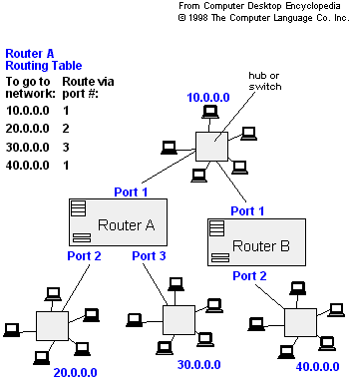
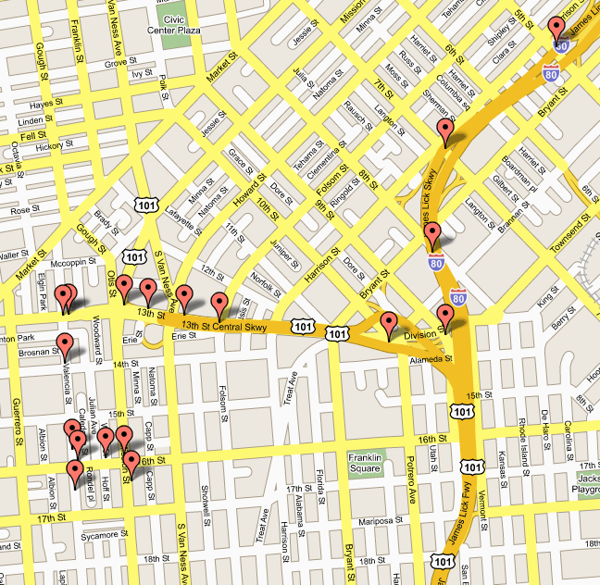
Applications of Dijkstra's Algorithm
- Traffic Information Systems are most prominent use
- Mapping (Map Quest, Google Maps)
Routing Systems
Prof. Lauren Meyers (Biology Dept.) uses networks to model the spread of infectious diseases and design prevention and response strategies.

Slide 28
Learning Outcome of the Experiment and Conclusion
At the end of the session, students should be able to :
Explain the working of Greedy technique. [L2, CO 2, PO1]
Demonstrate the working of Dijkstra algorithm. [L3, CO 2, PO3]
Compute the shortest path between a source and all vertices in a weighted connected graph. [L3, CO 2, PO3]

Slide 29
THANKING YOU ALL

